Slide 1
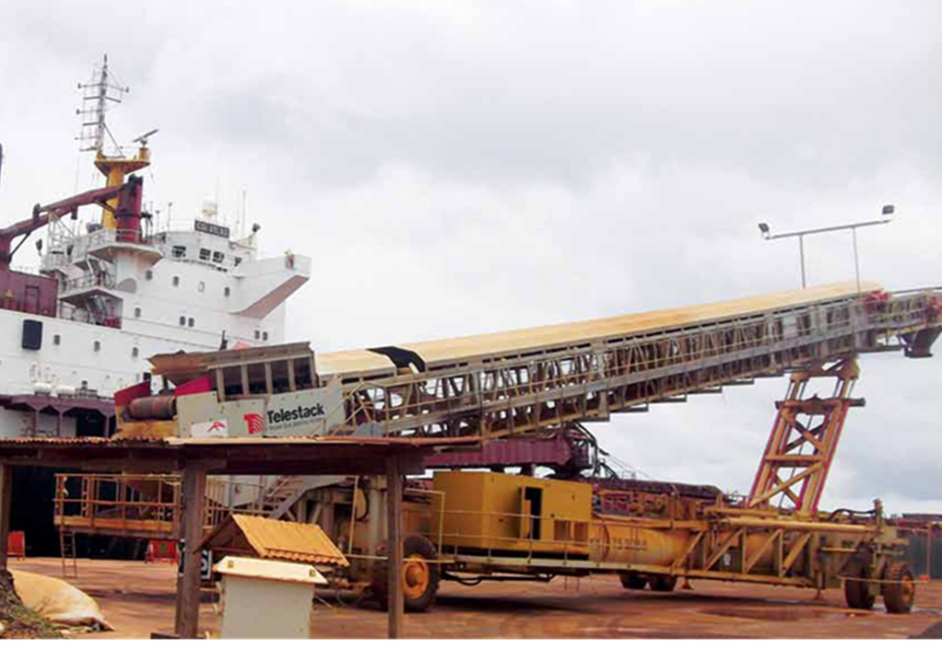


LEITI Technical Workshop
13th and 14th Reports

Slide 2

Outline
Introduction
Overview of the 2019 EITI Standard
EITI Process
Traditional vs Flexible Reporting
What it means for LEITI
Reporting Period
Timeline

Slide 3
Introduction
Baker Tilly – Liberia and SRG Consulting, LLC – USA are partnering to produce the FY 2019/20 (13th) and FY 2020/21 (14th) EITI Reports for Liberia
Reports will be published under the 2019 EITI Standard and not the 2016 EITI Standard – meaning some requirements are mandatory and voluntary
Covid -19 and EITI Disclosures/Reporting
  Flexible (Flex) Reporting and Liberia EITI

Slide 4
EITI 2019 Standard: The Changes
Gender (Requirements 1.4 - 6.3 - 7.1 - 7.4)
MSGs are required to consider gender balance in their representation to progress towards gender parity (1.4.a.ii). New Requirement
EITI reporting should provide employment figures disaggregated by project and gender where available (6.3.d). New Requirement
MSGs should consider information access challenges and information needs of different genders and sub-groups of citizens (7.1.ii). New Encouragement
MSGs are encouraged to document efforts to improve gender equality and social inclusion in their annual review of impacts and outcomes (7.4.v). New Encouragement

Slide 5
EITI 2019 Standard: The Changes
Contract Transparency (Requirements 2.4 - 2.1)
Contracts entered into, signed or amended from 1 January 2021 are required to be made public (2.4.a). New Requirement
MSGs are expected to agree and publish plans for disclosing contracts in workplans covering 2020 onwards (2.4.b). New Expectation
EITI reporting should describe the different types of contract that exist (2.1.a). New Requirement
EITI reporting should describe the government’s policy and actual practice on disclosure of contracts (2.4.c). New Requirement

Slide 6
EITI 2019 Standard: The Changes
Contract Transparency (Requirements 2.4 - 2.1)
Contracts entered into, signed or amended from 1 January 2021 are required to be made public (2.4.a). New Requirement
MSGs are expected to agree and publish plans for disclosing contracts in workplans covering 2020 onwards (2.4.b). New Expectation
EITI reporting should describe the different types of contract that exist (2.1.a). New Requirement
EITI reporting should describe the government’s policy and actual practice on disclosure of contracts (2.4.c). New Requirement

Slide 7
EITI 2019 Standard: The Changes
Commodity Trading (Requirement 4.2)
Where the sale of a state’s share of production of oil, gas and/or minerals or other revenues collected in kind is material, the government, including SOEs, are required to disclose the volumes received (4.2.a)
New Requirement
Volumes and values of oil, gas and minerals should be disaggregated by sales contract (4.2.a). New Requirement
Implementing countries including SOE’s are encouraged to disclose the process for selecting buyers and sales contracts (4.2.b). New Encouragement
Companies buying oil, gas and/or minerals resources from the state, including SOE’s are encouraged to disclose volumes received and payments made (4.2.c). New Requirement

Slide 8
EITI 2019 Standard: The Changes
SOE Disclosures (Requirements 2.6 - 6.2)
Explanation of the role of SOEs and the rules and practices regarding the financial relationship between the state and SOEs. This should include disclosures of joint ventures and subsidiaries (2.6.a.i). New Expectation
Loan details to be disclosed include repayment schedule and interest rate (2.6.ii). New Expectation
SOEs are expected to publicly disclose their audited financial statements or main financial items (i.e. balance sheet, cash flows) (2.6.b). New Expectation
MSG may wish to take the IMF’s definition of quasi-fiscal expenditures into account when considering whether expenditures are quasi-fiscal (6.2). New Encouragement

Slide 9
EITI 2019 Standard: The Changes
Licensing (Requirement 2.2)
Explanation of the role of SOEs and the rules and practices regarding the financial relationship between the state and SOEs. This should include disclosures of joint ventures and subsidiaries (2.6.a.i). New Expectation
The MSG may wish to include additional information on the allocation of licenses. This could include commentary on efficiency and effectiveness of licensing procedures, description of procedures, actual practices and grounds for renewing, suspending or revoking a contract or license. (2.2.d). New Encouragement

Slide 10
EITI 2019 Standard: The Changes
Production and exports (Requirements 3.2 - 3.3)
Production data could be further disaggregated by region, company or project, and include sources and the methods for calculating production volumes and values (3.2). New Encouragement

Slide 11
EITI 2019 Standard: The Changes
Subnational transfers (Requirement 5.2)
The MSG may wish to report on how extractives revenues earmarked for specific programmes or investments at the subnational level are managed, and actual disbursements. (5.2.c) New Encouragement

Slide 12
EITI 2019 Standard: The Changes
Data Timeliness (Requirement 4.8)
The data must be no older than the second to last complete accounting period e.g. information for 2018 must be published at the latest by 31 December 2020 (4.8.b) New Encouragement

Slide 13
EITI 2019 Standard: The Changes
Recommendations for EITI implementation (Requirement 7.3)
The MSG can consider agreeing recommendations for strengthening government systems and natural resource governance. Where appropriate, implementing countries are encouraged to follow-up such recommendations (7.3). Introduced Flexibility

Slide 14
EITI 2019 Standard: The Changes
Project-level reporting (Requirement 4.7)
New definition of project in line with emerging practices; “Operational activities that are governed by a single contract, license, lease, concession or similar legal agreement, and form the basis for payment liabilities with a government” (4.7). Clarification

Slide 15
EITI 2019 Standard: The Changes
Systematic disclosure (Requirement 4.1)
Companies are expected to publicly disclose their audited financial statements or the main items (i.e. balance sheet, cash flows) (4.1.e). New Expectation

Slide 16
EITI 2019 Standard: The Changes
Licensing (Requirement 2.2)
Explanation of the role of SOEs and the rules and practices regarding the financial relationship between the state and SOEs. This should include disclosures of joint ventures and subsidiaries (2.6.a.i). New Expectation
The MSG may wish to include additional information on the allocation of licenses. This could include commentary on efficiency and effectiveness of licensing procedures, description of procedures, actual practices and grounds for renewing, suspending or revoking a contract or license. (2.2.d). New Encouragement

Slide 17
LEITI and EITI Flexible Reporting
MSGs may prepare EITI Reports planned for publication in 2020 and 2021 based on the information disclosed by the government and/or companies, (i.e. unilateral disclosures – no reconciliation required).
Conditions for Flexible Reporting:
    subject to MSG endorsement and providing that the flexible reporting requirements are met.
    be clearly documented and shared with the International Secretariat before starting the reporting process.
    MSGs are encouraged to use this flexibility to communicate timely data that is relevant to the situation in their country.
    Implementing countries may deviate from the standard procedure for EITI reporting, including reconciliation for EITI Reports scheduled for publication in 2020 and 2021. In doing so, the country must disclose the following information in its reporting:
    Information on current and forward-looking extractive sector developments and industry outlook, in light of COVID-19, commodity price shocks, and the potential for longer-term reductions in demand for commodities.
    Unilateral disclosures by government and/or companies in accordance with EITI Requirements 2, 3, 4, 5 and 6, with the exception of provisions relating to data quality and assurance (Requirement 4.9b).
    Disclosures of the latest production, export and revenue data.

Slide 18
Additional Things to Consider Under Flex Reporting
Changes to the licensing and contract negotiation process
Adjustments to fiscal regimes/terms
Incentives or relief requested by or given to companies
Effects on exploration or development plans
Impact on production, exports, and employment
Changes in state participation and policies for state-owned enterprises
Revisions to revenues and budget projections
Shifts in sector-specific borrowing
Restrictions on civic space
Exceptional uses of sovereign wealth funds
Other issues as agreed by the MSG

Slide 19
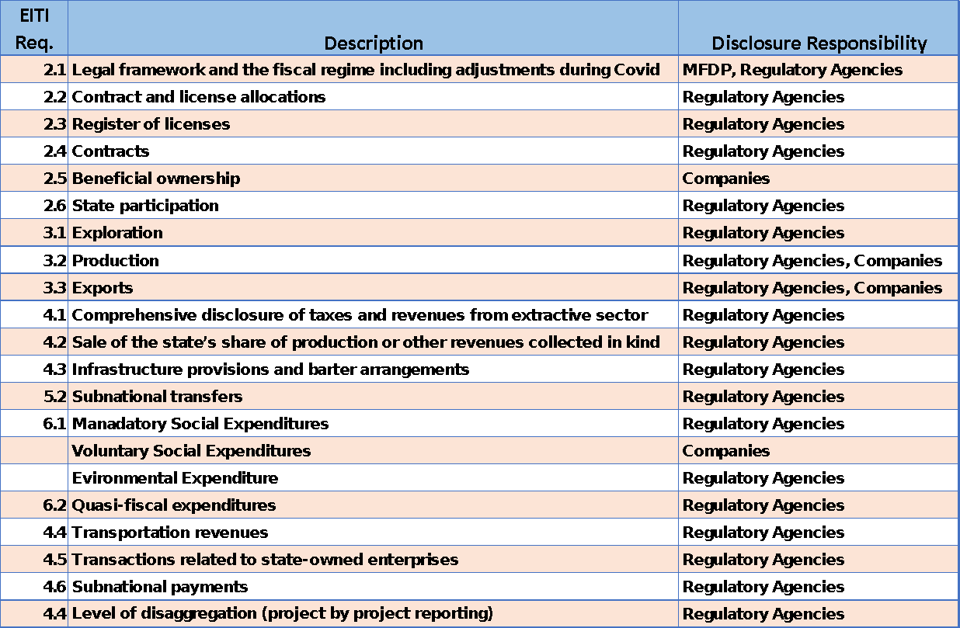
What It Means to You

Slide 20
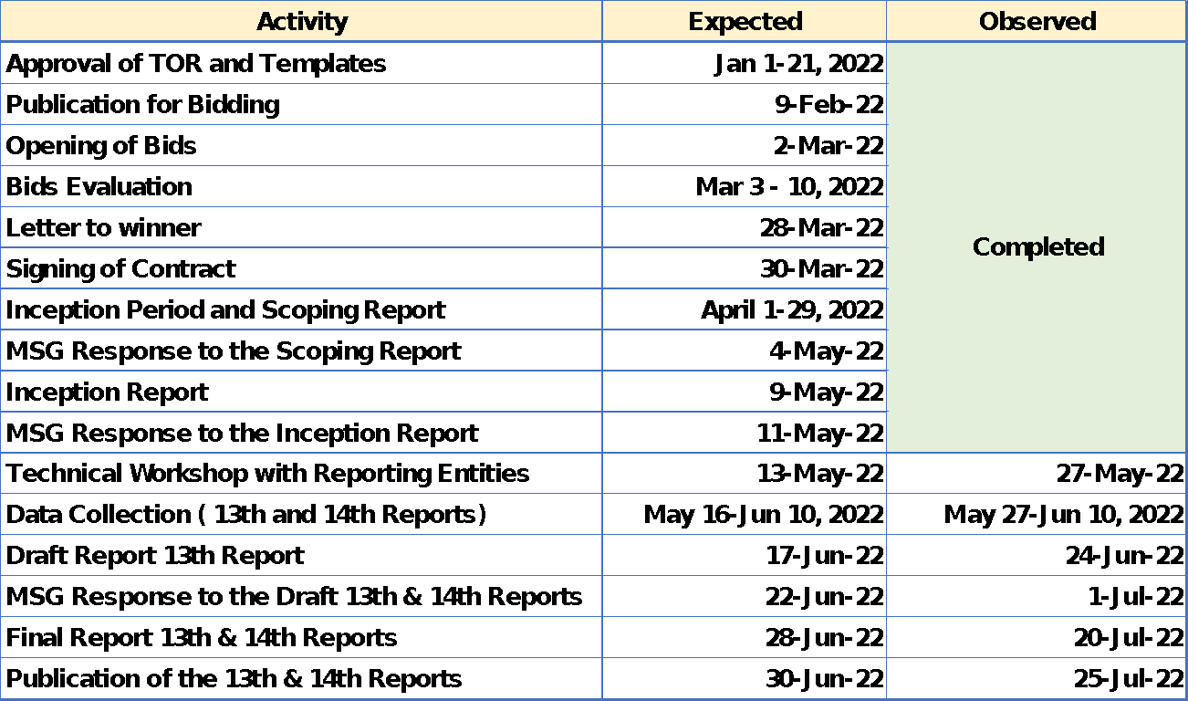
Timeline

Slide 21
Review of Reporting Templates

Slide 22
Quality Assurance
Government Agencies
  Templates are valid or met quality assurance if:
    Signed off by an Authorized Senior Manager (i.e. Unit Head, Managing/Deputy Managing Director, Deputy Managing Director, etc), Minister (Assistant, Deputy, Proper, etc.), AND
    Templates must be certified by the GAC in keeping with conditions set forth in an Agreed-Upon Procedures between LEITI and the GAC.
State-Owned Enterprise (SOE)
  Templates are valid or met quality assurance if:
    Signed off by an Authorized Senior Manager (i.e. Chief Accountant, Vice President, President, Comptroller, Chief Operating Officer, etc.), AND
    Templates must be certified by the GAC in keeping with conditions set forth in an Agreed-Upon Procedures between LEITI and the GAC.
Extractive Companies
  Templates are valid or met quality assurance if:
    Signed off by an Authorized Senior Manager (i.e. Chief Accountant, Vice President, President, Comptroller, Chief Operating Officer, etc.), OR the entity’s External Auditor
    Audited financial statements MAY be accepted as part of the data submission process.

Slide 23


